Slide 1
Vein Authentication System
University Of Karachi
Department Of Computer Science
Group Members:
M. Muneeb Baig
Muhammad Fahad
Munib Deshmukh
Maaz Anzar
Course Supervisor: Dr. Humera Tariq

Slide 2
Contents
Problem Statement
Why It is important to Solve the Chosen Problem?
Data Acquisition (Input Images)
Proper Block Diagram
GUI
intermediate and output images (Important Results)
Preprocessing Details
Algorithm Description
Image Segmentation
Feature Extraction
Matching Criteria
Challenges/ Difficulties
Learning and Achievements
Improvements and Future Work
Demo and Queries

Slide 3
Problem Statement
To protect the possessions that needs to be accessed by the authorized person’s identity
To prevent any fraudulent act to steal possessions by bypassing the security system
To ensure safety and security.

Slide 4
Importance
Organizations needed bio-metric system to protect their data from their competitors.
Government should have very strong system to combat identity fraud and security breaches, Secure confidential data, Reduce cost
Biometrics is one of the rapidly growing fields in the information technology sector.

Slide 5
Various Biometric Systems
Fingerprint – Uses the ridges and valleys pattern from the surface of the fingertip
Iris Recognition – uses the iris unique patterns to do the matching
Face characteristics – utilizes the facial features for the recognition.
Hand Geometry-Use characteristics of hand.

Slide 6
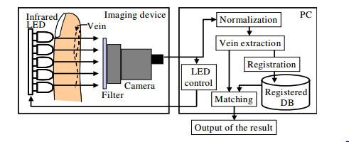
Data Acquisition
There are two types of infrared images far-infrared(FIR) and the near infrared(NIR) imaging, Captured human bodies images in a non-harmful way is through near-infrared region.
Vein Scanner is the basic device that is used for vein scan. This device is capable to capture finger vein pattern. With the help of infrared leds which emits near infrared rays

Slide 7
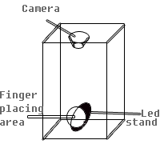
Cont…
This actual diagram of vein scanner is

Slide 8
Input Image
Normalization
Extraction
Featured Templates
Matching
Reject
Accept

Slide 9
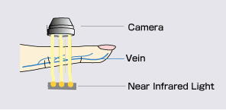
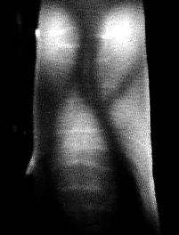
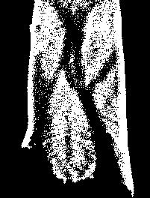
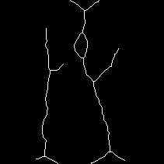


Block Diagram
Vein Scanner
Captured image
Vein Extraction
Skeleton Image
Pattern Split
Noise Removal

Slide 10
FLOW OF WORK
Image Acquisition – contrast, brightness, exposure, sharpness adjustment.
Preprocessing – dark extra region is removed.
Region Extraction – adaptive thresholding by using “Bradley function”.
Vein Pattern Extraction – extracted pattern.
Noise Removal – cleaning, filling and removing of small dots.
Pattern Split – extra noise is removed.
Skeleton – skeletonize the resulting image.
Smoothing – eliminating small braches.
Feature extraction – by using min max algorithm.

Slide 11
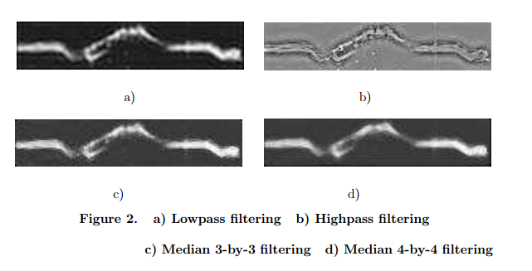
Pre procssing
The goal of pre-processing is an improvement of data in an image that decreases
un desired distortions and enhances few of images features that is relevant of
future processing and analysis task.
Cropping Of Image - Image cropping is the elimination of irrelevant part of image and focuses on the region of interest in the image.
Filtering Image - A non-linear smoothing method Median filtering that reduces the blurring of edges and significantly eliminates high frequency noise .

Slide 12
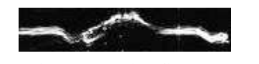

Cont…
Intensity Adjustment - It is in simple wording adjustment of brightness and contrast.
Histogram Equalization - The contrast of image, by transforming the values in an intensity image so that the histogram of the output image matches a specified histogram.

Slide 13
Algorithm Description
In this algorithm we have calculated 20 values of each minimum and maximum along x-axis, If there is only one cross section than there will be zero minimum and maximum shown in figure.
When only two cross sections found it means that both values are same, more than two considering only minimum and maximum value others are ignored and when very next to cross section another one found than above one will be considered as irrelevant.

Slide 14
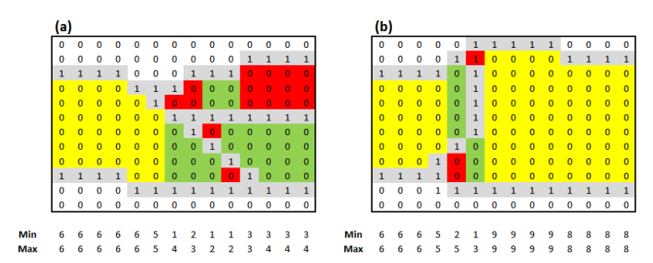
Red is minimum
Green is maximum
Yellow means both

Slide 15
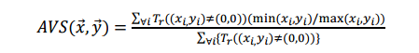
Cont..
Similarity between the two vectors is define by the formula shown below. reflecting average similarity vector. which is calculated by dividing minimum with other sample’s minimum ,than calculate its average similarity with the help of equation below, vice versa with the maxims.
The Average similarity vector will have ranges between 0 and 1, where 1 means full match and 0 means mismatch.

Slide 16
GUI
In this section we show our GUI so that viewers can understand the interaction in between input and output.

Slide 17
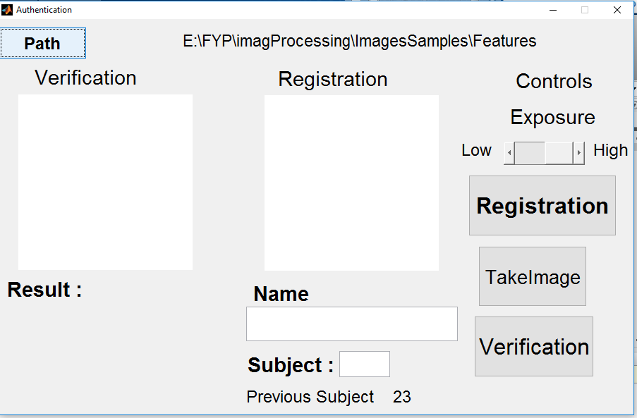

Slide 18
Results
Before getting into the theoretical/Mathematical details we will show viewers some important results to grasp the techniques and concepts.

Slide 19
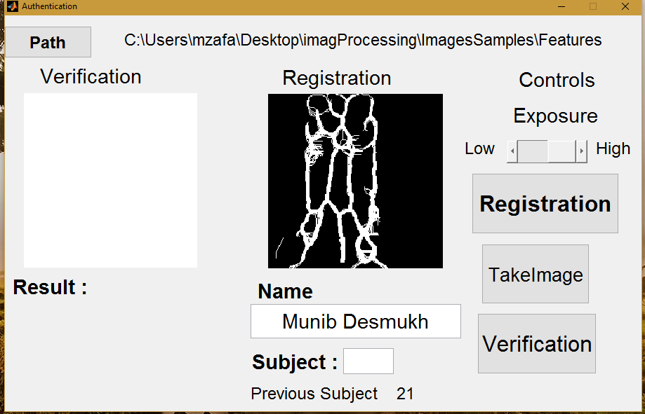

Slide 20
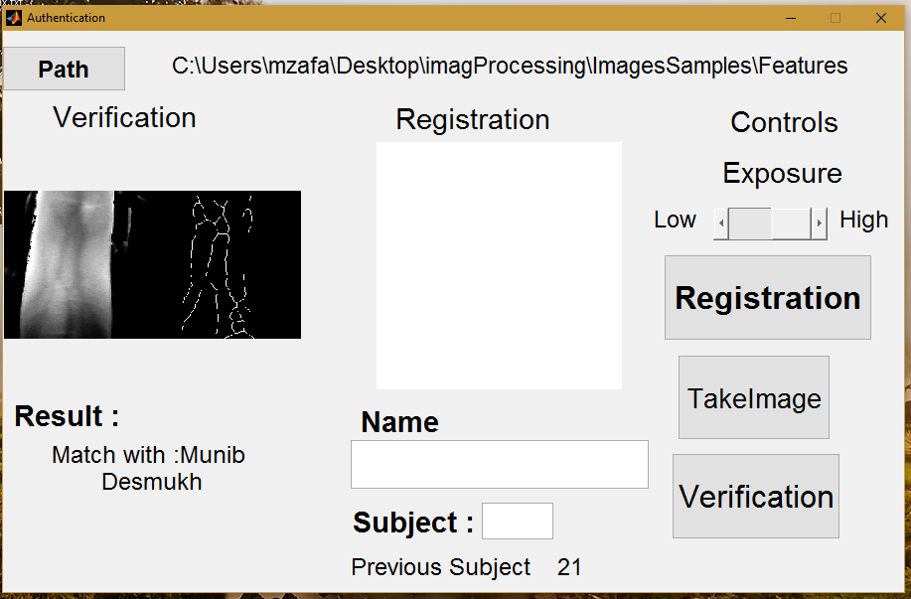

Slide 21
Learning and Achievements
About Different concept of image processing like .
Adaptive thresholding.
Fast Fourier transformation.
High pass / low pass filter.
Butter worth high pass filter.
Neighborhood processing.
Segmentation.
Opening and closing binary areas.
Image Preprocessing.
Image Thinning.
Feature Extraction.
Matching Features.

Slide 22
Improvements
Finger alignment needs to improved b/c it affect the accuracy of results
Other types of feature algorithm can be applied to improve performance.
Hardware leds of hardware can be increased to improve image acquision
Little bit performance need to be improved so that it will save time.

Slide 23
Applications
ATM and other financial transactions.
Biometric Time Attendance System
Enrollment system
Database access
Internet banking

Slide 24
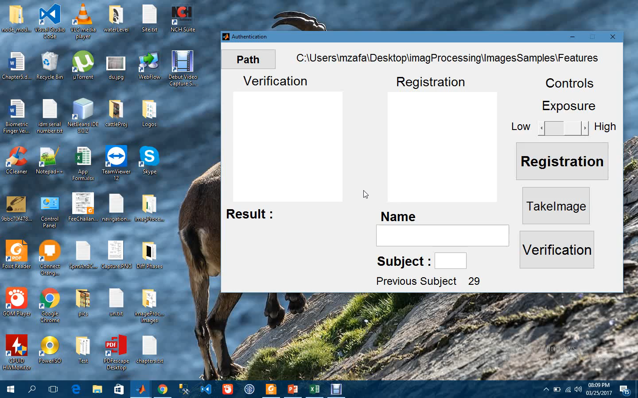
Demo and Queries

